Slide 1

Computer Architecture
A Quantitative Approach
Appendix A & C
MIPS ISA & Instruction Processing

Slide 2
MIPS ISA & PIPELINING
- CHAPTER 1, APPENDIX A / C

Slide 3
Outline
MIPS – An ISA for Pipelining
5 stage pipelining
Structural and Data Hazards
Forwarding
Branch Schemes
Exceptions and Interrupts
Conclusion

Slide 4
A "Typical" RISC ISA (32-bit version)
32-bit fixed format instruction (only 3 formats: R, I, J)
32 32-bit GPR (R0 contains zero, DP takes pair)
3-address, register-register arithmetic instruction
Single address mode for load/store
  Simply, base + displacement
  No memory indirection (since it needs another memory access)
Simple branch conditions (e.g., single-bit: 0 or not?)
Delayed branch (helped by compiler)
  ineffective in deep pipelines, so no longer used

Slide 5
Example: MIPS
Register-Register – R Format – Arithmetic operations
31 26 25 21 20 16 15 11 10
6 5
0
Op | rs | rt | rd | shamt | funct
Register-Immediate – I Format – All immediate arithmetic ops
31 26 25 21 20 16 15
0
Op | rs | rt | immediate
Branch – I Format – Moderate relative distance conditional branches
31 26 25 21 20 16 15 0
Op | rs | rt/opx | immediate
Jump / Call – J Format – Long distance jumps
31 26 25
0
Op
Offset added to PC

Slide 6
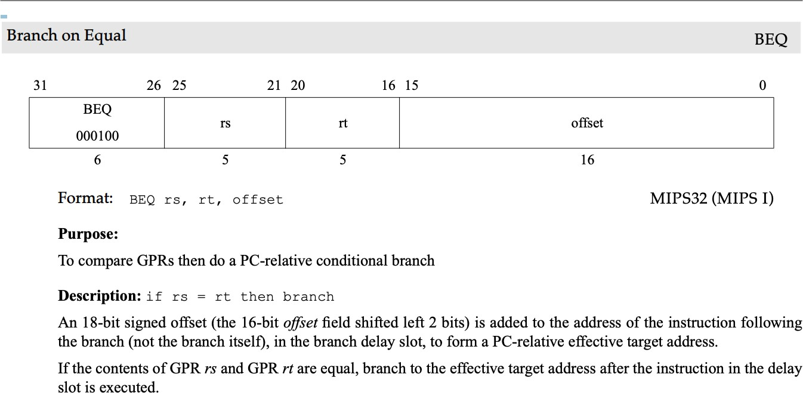
Example: BEQ

Slide 7
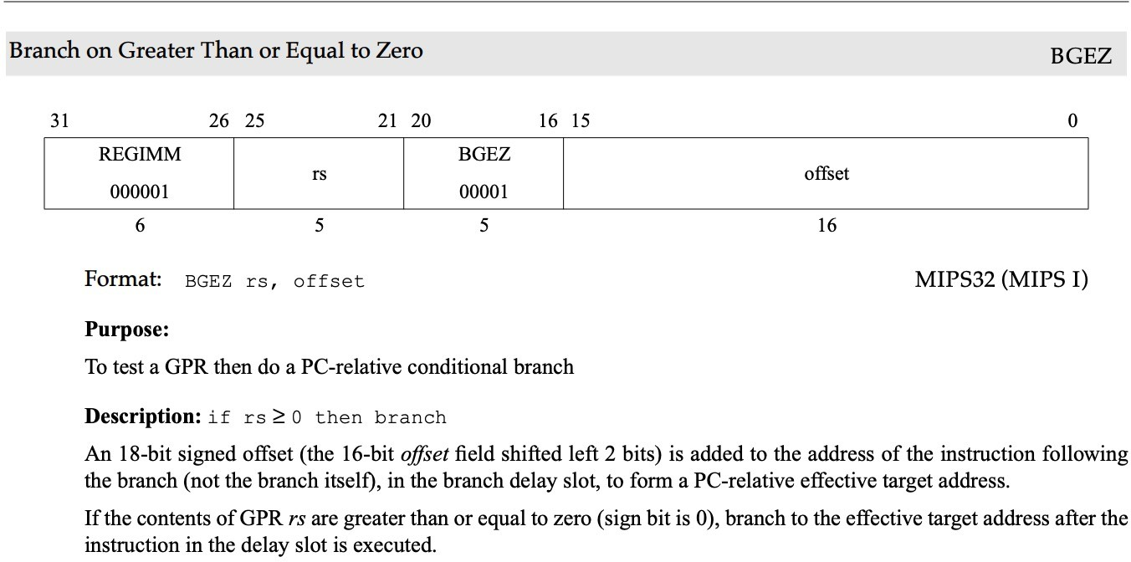
Example: BGEZ
rt field is used to identify specific branch instruction

Slide 8
Pseudo-instructions
Do not have hardware implementation
Instead, mapped to multiple basic instructions
Convenience for programmers
Examples
– li R16, 10
will be translated to: ori R16, R0, 10
  blt R9, R10, target
will be translated to:
slt R1, R9, R10
bne R1, R0, target
  Note that in the real code, we use mnemonics (like $t0 or $s0)
Notes:
ORI: bitwise OR of contents from register and an immediate value

Slide 9
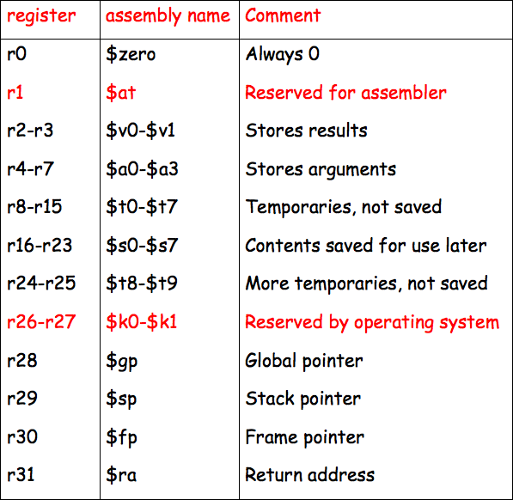
MIP Registers
http://homepage.cs.uiowa.edu/~ghosh/01-23-07.pdf
Fig. 1.4 in textbook (5th edition)
Notes:
We will use MIPS32/MIPS64 ISA.

Slide 10
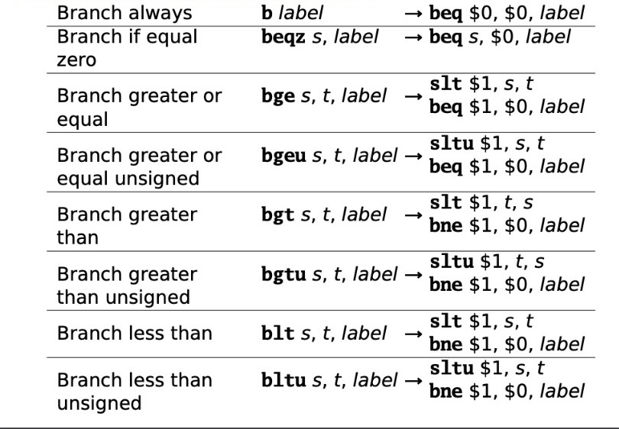
Pseudo-instruction Examples
source: http://www.cs.columbia.edu/~martha/courses/3827/au15/mips-isa.pdf

Slide 11
Example 1: Conditional if
Convert the following C code snippet to MIPS32,
assuming that i and j are already loaded into $s1
and $s2 respectively.
if ( i == j )
i++; // if-body
j--;
MIPS Implementation:
bne $s1, $s2, L1
addi $s1, $s1, 1
L1: addi $s2, $s2, -1
Notes:
bne $s1, $s2, L1
addi $s1, $s1, 1
L1: addi $s2, $s2, -1

Slide 12
Example 2: Conditional if-else
Convert the following C code snippet to MIPS32,
assuming that i and j are already loaded into $s1
and $s2 respectively.
if ( i == j )
i++; // if-body
else
j--; // else-body
j += i;
Notes:
bne $s1, $s2, ELSE
addi $s1, $s1, 1
j NEXT
ELSE: addi $s2, $s2, -1
NEXT: add $s2, $s2, $s1
A common mistake is not to include the jump instruction in the if-body.

Slide 13
Example 2: Conditional if-else (Solution)
MIPS Implementation:
bne $s1, $s2, ELSE
addi $s1, $s1, 1
j NEXT
ELSE: addi $s2, $s2, -1
add $s2, $s2, $s1
A common mistake is not including a jump instruction in the if-body.
NEXT:
Notes:
bne $s1, $s2, ELSE
addi $s1, $s1, 1
j NEXT
ELSE: addi $s2, $s2, -1
NEXT: add $s2, $s2, $s1
A common mistake is not to include the jump instruction in the if-body.

Slide 14
Example 3: Conditional compound condition
C code snippet:
if ( i == j && i == k )
i++; // if-body
else
j--; // else-body
j += i + k;
MIPS Implementation: (assume $s1=i, $s2=j, $s3=k)
bne $s1, $s2, ELSE
bne $s1, $s3, ELSE
addi $s1, $s1, 1
j NEXT
ELSE: addi $s2, $s2, -1
NEXT: add $s2, $s1, $s2
add $s2, $s3, $s2
AND condition
Short circuiting occurs when the first condition is false.
Notes:
bne $s1, $s2, ELSE
bne $s1, $s3, ELSE
addi $s1, $s1, 1
j NEXT
ELSE: addi $s2, $s2, -1
NEXT: add $s2, $s1, $s2
add $s2, $s3, $s2
Short circuiting occurs when the first condition is false.

Slide 15
Example 4: Conditional compound condition
C code snippet:
if ( i == j || i == k )
i++; // if-body
else
j--; // else-body
j += i + k;
MIPS Implementation: (assume $s1=i, $s2=j, $s3=k)
beq $s1, $s2, IF
bne $s1, $s3, ELSE
IF: addi $s1, $s1, 1
j NEXT
ELSE: addi $s2, $s2, -1
NEXT: add $s2, $s1, $s2
add $s2, $s3, $s2
OR condition
Short circuiting occurs when the first condition is true.
Notes:
beq $s1, $s2, IF
bne $s1, $s3, ELSE
IF: addi $s1, $s1, 1
j NEXT
ELSE: addi $s2, $s2, -1
NEXT: add $s2, $s1, $s2
add $s2, $s3, $s2
Short circuiting occurs when the first condition is true.

Slide 16
Example 5: Conditional switch
C code snippet:
switch ( i )
case 1: i++; // falls through
case 2: i += 2;
break;
case 3: i += 3
Notes:
addi $s4, $zero, 1
bne $s1, $s4, C2_COND
j C1_BODY
C2_COND: addi $s4, $zero, 2
bne $s1, $s4, C3_COND
j C2_BODY
C3_COND: addi $s4, $zero, 3
bne $s1, $s4, EXIT
j C3_BODY
C1_BODY: addi $s1, $s1, 1
C2_BODY: addi $s1, $s1, 2
j EXIT
C3_BODY: addi $s1, $s1, 3
EXIT:

Slide 17
Example 5: Conditional switch (Solution)
MIPS Implementation:
addi $s4, $zero, 1 # c1: temp=1
bne $s1, $s4, C2_COND
j C1_BODY
C2_COND: addi $s4, $zero, 2 # c2: temp=2
bne $s1, $s4, C3_COND
j C2_BODY
C3_COND: addi $s4, $zero, 3 # c3: temp=3
bne $s1, $s4, EXIT
j C3_BODY
C1_BODY: addi $s1, $s1, 1 # case 1: i++;
C2_BODY: addi $s1, $s1, 2 # case 2: i += 2;
j EXIT # break;
C3_BODY: addi $s1, $s1, 3 # case 3: i += 3;
EXIT:
Notes:
addi $s4, $zero, 1
bne $s1, $s4, C2_COND
j C1_BODY
C2_COND: addi $s4, $zero, 2
bne $s1, $s4, C3_COND
j C2_BODY
C3_COND: addi $s4, $zero, 3
bne $s1, $s4, EXIT
j C3_BODY
C1_BODY: addi $s1, $s1, 1
C2_BODY: addi $s1, $s1, 2
j EXIT
C3_BODY: addi $s1, $s1, 3
EXIT:

Slide 18
Example 6: While loop
C code snippet:
while ( i < j ) {
k++;
i = i + 2;
}
MIPS Implementation: (assume $s1=I, $s2=j)
L1: bge $s1, $s2, DONE # branch if !(i < j)
addi $s3, $s3, 1 # k++
add $s1, $s1, $s1 # i = i * 2
j L1
DONE:
L1: if ( i < j ) {
k++;
i = i + 2;
goto L1;
}
Notes:
L1: bge $s1, $s2, DONE # branch if !(i < j)
addi $s3, $s3, 1 # k++
add $s1, $s1, $s1 # i = i * 2
j L1
DONE:

Slide 19
Example 7: For loop
for ( <init> ; <cond> ; <update> ) {
<for-body>
}
Equivalent while loop:
<init>;
while ( <cond> ) {
<for-body>
<update>
}
<init>;
L1: if ( <cond> ) {
<for-body>
<update>
goto L1;
}

Slide 20
Practice: Load and Store
See Q3. on practice set 1.
Notes:
a)
LD $t1, 2000($0)
LD $t2, 2008($0)
SLT $t3, $t2, $t1
BEQ $t3, $0, DONE
DADD $t4, $t2, $t1
DSUB $t4, $0, $t4
SD $t4, 2016($0)
DONE:
b) 4 instructions
c) 2
d) 28 bytes

Slide 21
SPIM MIPS Simulator
QtSpim: a simulator for MIPS32
URL
https://spimsimulator.sourceforge.net/
QtSpim
https://sourceforge.net/projects/spimsimulator/files/
Source Code
https://sourceforge.net/p/spimsimulator/code/HEAD/tree/

Slide 22
Data Path &
Control Flow
- APPENDIX A / C

Slide 23
Data path vs. Controller
Datapath
Controller
signals
Control Points
Data path: Storage, Functional Units, Interconnections sufficient to perform the desired functions
  Inputs are Control Points
  Outputs are signals
Controller: State machine to orchestrate operation on the data path based on desired function and signals
Notes:
>>
A processor is fundamentally composed of two main components:
the data path and
the controller (or control unit)
A data path is a collection of
functional units,
storage elements,
and interconnections
designed to perform data processing and transfer operations.
It encompasses
storage components like registers and memory,
functional units such as arithmetic logic units (ALUs) and multipliers,
and the routing infrastructure like buses and multiplexers.
The data path is responsible for executing the computational tasks defined by the system’s ISA.
The controller, is responsible for managing the data path's operation
and can be implemented as
a finite state machine (FSM),
a stored program,
or a combination of both.
It receives external control inputs and status signals from the data path, and in response, generates control signals to orchestrate the sequence of operations, enabling or disabling specific components and managing timing.
The controller ensures that data flows correctly through the data path by interpreting status signals and issuing the appropriate control signals to achieve the desired function.

Slide 24
Un-pipelined Implementation
Single-cycle implementation
  Sequential, no parallelism
  One (long) cycle for processing each instruction
  Clock Cycle Time must be set long enough, so the longest-time-taking instruction can be processed within the cycle time
Multi-cycle implementation
  Sequential, no parallelism
  Processing instructions in multiple separate stages
  1 cycle for each stage
  The number of cycles needed for an instruction varies.
  Clock Cycle Time must be set to the time for the longest stage

Slide 25
5 Steps of a (un-pipelined) MIPS Data Path
Figure C.21
Stages: 1
Instruction Fetch
Next PC
2
Instr. Decode Reg. Fetch
3
Execute Addr. Calc
4
Memory Access
5
Write Back
MUX
Adder
Next SEQ PC
PC
4
Zero?
IR
RS1
Address
Memory
Inst
RS2
Reg File
MUX
ALU
RD
Data Memory
L M D
MUX
MUX
Imm
Sign Extend
WB Data
Notes:
IR: Instruction register
MUX (Multiplexer): used to select one output from multiple input data streams based on control signals generated by the control unit

Slide 26
Instruction Set Processor Controller
IR ← mem[PC];
PC ← PC + 4
Fetch
A ← Reg[IR_{rs}];
B ← Reg[IR_{rt}]
opFetch-DeCoDe
JAL
JR
ST
branch
jmp
RI
LD
RR
if bop(A,B) PC ← PC+IR_{im}
PC ← IR_{jaddr}
r ← A op_{IRop} B
r ← A op_{IRop} IR_{im}
r ← A + IR_{im}
WB ← r
WB ← r
WB ← Mem[r]
Reg[IR_{rd}] ← WB
Reg[IR_{rd}] ← WB
Reg[IR_{rd}] ← WB
Notes:
IR: Instruction register
IR ← Mem[PC], meaning the instruction register is loaded with the contents of the memory location pointed to by the program counter
JAL (Jump and Link): used to call a subroutine by jumping to a target address and saving the return address in register $ra (register 31)
JR (Jump Register): performs an unconditional jump to an address specified in a register
J (Jump): performs an unconditional jump to a specified target address, which is calculated by adding an immediate offset to the program counter (PC)

Slide 27
5 Steps of a MIPS Data Path
(with pipeline latches, Figure C.22)
Stages: 1
2
Instr. Decode Reg. Fetch
3
Execute Addr. Calc
4
Memory Access
5
Write Back
Instruction Fetch
Next PC
IF/ID
ID/EX
EX/MEM
MUX
MEM/WB
Next SEQ PC Next SEQ PC
Adder
4
Zero?
Address
RS1
Memory
RS2
Reg File
MUX
ALU
Data Memory
MUX
MUX
IR ⬅ mem[PC]; #1 PC ⬅ PC + 4
Sign Extend
WB Data
A ⬅ Reg[IR_{rs}]; #2
B ⬅ Reg[IR_{rt}]
Imm
RD
RD
RD
rslt ⬅ A op_{IRop} B #3
WB ⬅ rslt #4
Reg[IR_{rd}] ⬅ WB #5
Notes:
Pipeline latches
are interface registers used to hold intermediate data between stages in a pipelined processor.
IF/ID, ID/EX, EX/MEM, MEM/WB components are
buffers that hold information produced in one stage for use in the next stage
MUX (Multiplexer): used to select one output from multiple input data streams based on control signals generated by the control unit

Slide 28
Visualizing Pipelining
Figure C.3
Time (clock cycles)
Cycle 3 Cycle 4 Cycle 5
Cycle 1
Cycle 2
Cycle 6
Cycle 7
I
n s
t r.
Ifetch
Reg
ALU
DMem
Reg
Ifetch
Reg
ALU
DMem
Reg
O
r d
e r
Ifetch
Reg
ALU
DMem
Reg
Ifetch
Reg
ALU
DMem
Reg

Slide 29
Review Question
How many cycles are needed to process 5 instructions using a single-cycle MIPS ISA implementation?
A. 5
B. 6
C. 7
D. 8
E. 9
Notes:
5, CCT = longest instruction time

Slide 30
Review Question
How many cycles are needed to process 5 instructions using a multi-cycle MIPS ISA implementation?
Notes:
25, CCT = longest stage time

Slide 31
Review Question
How many cycles are needed to process 5 instructions using the pipelined MIPS implementation discussed?
A. 5
B. 6
C. 7
D. 8
E. 9
Notes:
9, CCT = longest stage time

Slide 32
HAZARDS IN PIPELINING
- APPENDIX C

Slide 33
Pipelining is not quite that easy!
Limits to pipelining: Hazards prevent next instruction from executing during its designated clock cycle
Structural hazards
» Hardware cannot support this combination of instructions
» e.g., having a single person to fold and put clothes away at same time
Data hazards
» Instruction depends on result of prior instruction still in the pipeline
» e.g., having a missing sock in a later wash; cannot put away
Control hazards
» Caused by delay between the fetching of instructions and decisions about changes in control flow (branches and jumps).

Slide 34
One Memory-Port / Structural Hazards
Figure C.4
Time (clock cycles)
Cycle 2 Cycle 3 Cycle 4 Cycle 5
Cycle 1
Cycle 6
Cycle 7
Cycle 8
I
n s
t r.
Load
Ifetch
Reg
ALU
DMem
Reg
Instr 1
Ifetch
Reg
ALU
DMem
Reg
Instr 2
Ifetch
Reg
ALU
DMem
Reg
O
r
d e r
Instr 3
Ifetch
Reg
ALU
DMem
Reg
Instr 4
Ifetch
Reg
ALU
DMem
Reg

Slide 35
One Memory-Port / Structural Hazards
Figure C.4
Time (clock cycles)
Cycle 2 Cycle 3 Cycle 4 Cycle 5
Cycle 1
Cycle 6
Cycle 7
Cycle 8
I
n s
t r.
Load
Ifetch
Reg
ALU
DMem
Reg
Instr 1
Ifetch
Reg
ALU
DMem
Reg
Instr 2
Ifetch
Reg
ALU
DMem
Reg
O
r
d e r
Instr 3
Ifetch
Reg
ALU
DMem
Reg
Instr 4
Ifetch
Reg
ALU
DMem
Reg

Slide 36
One Memory-Port / Structural Hazards
Figure C.4
Time (clock cycles)
Cycle 2 Cycle 3 Cycle 4 Cycle 5
Cycle 1
Cycle 6
Cycle 7
Cycle 8
I
n s
t r.
Load
Ifetch
Reg
ALU
DMem
Reg
Instr 1
Ifetch
Reg
ALU
DMem
Reg
Instr 2
Ifetch
Reg
ALU
DMem
Reg
O
r
d e r
Instr 3
Ifetch
Reg
ALU
DMem
Reg
Instr 4
Ifetch
Reg
ALU
DMem
Reg

Slide 37
One Memory-Port / Structural Hazards
Similar to Figure C.5
Time (clock cycles)
Cycle 2 Cycle 3 Cycle 4 Cycle 5
Cycle 1
Cycle 6
Cycle 7
Cycle 8
I
n s
t r.
Load
Ifetch
Reg
ALU
DMem
Reg
Instr 1
Ifetch
Reg
ALU
DMem
Reg
Instr 2
Ifetch
Reg
ALU
DMem
Reg
O
r
d e r
Stall
Bubble
Bubble
Bubble
Bubble
Bubble
Instr 3
Ifetch
Reg
ALU
DMem
Reg
How do you “bubble” the pipe?
Notes:
In a basic 5-stage pipeline, an instruction can load data from memory in the same cycle that another instruction is fetched,
but this can lead to a structural hazard due to a resource conflict on the shared memory system.
This occurs because both operations require access to the same memory unit simultaneously,
which is a common issue in von Neumann architecture where instructions and data share the same memory.
To resolve this, one solution is to stall the instruction fetch for one cycle, allowing the memory access for the load instruction to complete first.
However, processors like ARM that use a Harvard architecture,
which separates instruction and data memory, avoid this structural hazard entirely.

Slide 38
Code Speed Up Equation for Pipelining
For simple RISC pipeline, Ideal CPI = 1,
^{CPI}pipelined
= Ideal CPI + Average Stall cycles per Inst
A best speedup case:
Assume that all instructions take 5 cycles in the multi-cycle model
Ideal CPI × Pipeline depth
Ideal CPI + Pipeline stall CPI Cycle Time_{pipelined}
Speedup =
×
^{Cycle Time}unpipelined
Pipeline depth
1 + Pipeline stall CPI Cycle Time_{pipelined}
Speedup =
×
^{Cycle Time}unpipelined
Assume stages are perfectly balanced and ignore cycle time overhead. Then,
Pipeline depth
Speedup =
1 + Pipeline stall CPI
Notes:
Cycle time overhead: from registers between stages

Slide 39



Example: Dual-port vs. Single-port
Machine A: Dual ported memory (“Harvard Architecture”)
Machine B: Single ported memory, but its pipelined implementation has a 1.05 times faster clock rate
Ideal CPI = 1 for both
Assume loads are 20% of instructions executed
$SpeedupA$ = $\frac{Pipeline depth}{1 + 0}$ x $\frac{Cycle Timeunpipelined}{Cycle Timepipelined}$
$SpeedupB$ = $\frac{Pipeline depth}{1 + 0.2 ∗ 1}$ x $\frac{Cycle Timeunpipelined}{\left(\frac{Cycle Timepipelined}{1.05}\right)}$
$\frac{SpeedupA}{SpeedupB}$ = $\frac{1.2}{1.05}$ = 1.14
Machine A is 1.14 times faster!!!
Notes:
However, processors like ARM that use a Harvard architecture,
which separates instruction and data memory, avoid this structural hazard entirely.
Speedup_{A} = Pipeline depth / (1+0) x Cycle Time_{unpipelined} / Cycle Time_{pipelined}
Speedup_{B} = Pipeline depth / (1+0.2 x 1) x Cycle Time_{unpipelined} / (Cycle Time_{pipelined} / 1.05)
Speedup_{A} / Speedup_{B} = 1.2 / 1.05 = 1.14

Slide 40
Data Hazard on Register R1 (If No Forwarding)
Figure C.6
Time (clock cycles)
Cycle 2 Cycle 3 Cycle 4 Cycle 5
Cycle 1
Cycle 6
Cycle 7
Cycle 8
I
n s t r.
add r1,r2,r3
Ifetch
Reg
ALU
DMem
Reg
No forwarding needed since write reg. in 1st half cycle, read reg.
in 2nd half cycle.
sub r4,r1,r5
Ifetch
Reg
ALU
DMem
Reg
and r6,r1,r7
Ifetch
Reg
ALU
DMem
Reg
O
r d e r
or r8, r1,r9
Ifetch
Reg
ALU
DMem
Reg
xor r10,r1,r11
Ifetch
Reg
ALU
DMem
Reg

Slide 41
Three Generic Data Hazards (1/3)
Read After Write (RAW)
Instr_{J} tries to read operand before Instr_{I} writes it
I: add r1,r2,r3 J: sub r4,r1,r3
Caused by a “(True) Dependence” (in compiler nomenclature). This hazard results from an actual need for communicating a new data value.

Slide 42
Three Generic Data Hazards (2/3)
Write After Read (WAR)
Instr_{J} writes operand before Instr_{I} reads it
I: sub r4,r1,r3 J: add r1,r2,r3 K: mul r6,r1,r7
Called an “anti-dependence” by compiler writers. This results from reuse of the name “r1”.
Cannot happen in MIPS 5 stage pipeline because:
  All instructions take 5 stages, and
  Register reads are always in stage 2, and
  Register writes are always in stage 5

Slide 43
Three Generic Data Hazards (3/3)
Write After Write (WAW)
Instr_{J} writes operand before Instr_{I} writes it.
I: sub r1,r4,r3 J: add r1,r2,r3 K: mul r6,r1,r7
Called an “output dependence” by compiler writers This also results from the reuse of name “r1”.
Cannot happen in MIPS 5 stage pipeline because:
  All instructions take 5 stages, and
  Register writes are always in stage 5
Will see WAR and WAW in more complicated pipes

Slide 44
Forwarding to Avoid Data Hazard
Figure C.7
Forwarding of ALU outputs needed as ALU
Forwarding of LW MEM outputs to SW MEM or
inputs 1 cycle later.
Time (clock
ALU inputs 2 cycles
cycles)
later.
Cycle 1
Cycle 2
Cycle 3
Cycle 4 Cycle 5
Cycle 6
Cycle 7
Cycle 8
I
n s
t r.
add r1,r2,r3
Ifetch
Reg
ALU
DMem
Reg
No forwarding needed since write reg. in 1st half cycle, read reg.
in 2nd half cycle.
sub r4,r1,r3
Ifetch
Reg
ALU
DMem
Reg
and r6,r1,r7
Ifetch
Reg
ALU
DMem
Reg
O
r
d e r
or r8, r1,r9
Ifetch
Reg
ALU
DMem
Reg
xor r10,r1,r11
Ifetch
Reg
ALU
DMem
Reg

Slide 45
HW Datapath Changes (in red) for Forwarding
Figure C.27
To forward ALU, MEM
2 cycles to
ALU
Next PC
To forward ALU output 1 cycle to ALU inputs
(1)
(3)
Mux
(From LW Data Memory)
Registers
ALU
EX/MEM
MEM/WR
ID/EX
Mux
Data Memory
Immediate
Mux
Mux
(From ALU)
(2)
To forward MEM 1 cycle to SW MEM input

Slide 46
Forwarding Avoids ALU-ALU & LW-SW Data Hazards
Figure C.8
Time (clock cycles)
Cycle 3 Cycle 4 Cycle 5
Cycle 1
Cycle 2
Cycle 6
Cycle 7
Cycle 8
I
n s
t r.
add r1, r2, r3
Ifetch
Reg
ALU
DMem
Reg
lw r4, 0(r1)
Ifetch
Reg
ALU
DMem
Reg
sw r4, 12(r1)
Ifetch
Reg
ALU
DMem
Reg
O
r
d e r
or r8, r6, r9
Ifetch
Reg
ALU
DMem
Reg
xor r10, r9, r11
Ifetch
Reg
ALU
DMem
Reg

Slide 47

LW-ALU Data Hazard Even with Forwarding
Figure C.9
Time (clock cycles)
Cycle 4 Cycle 5 Cycle 6
Cycle 1
Cycle 2
Cycle 3
Cycle 7 Cycle 8
No forwarding needed since write reg. in 1st half cycle, read reg.
in 2nd half cycle.
I
n
s t r.
lw r1, 0(r2)
Ifetch
Reg
ALU
DMem
Reg
sub r4, , r6
Ifetch
Reg
ALU
DMem
Reg
and r6, r1, r7
Ifetch
Reg
ALU
DMem
Reg
O
r d e r
or r8, r1, r9
Ifetch
Reg
ALU
DMem
Reg
Notes:
A load instruction's data cannot be forwarded directly to the ALU of another instruction in the same cycle to resolve a data dependency.
The load instruction accesses data memory in the MEM stage,
and the data becomes available at the end of that stage.

Slide 48
Data Hazard Even with Forwarding
(Similar to Figure C.10)
No forwarding needed since write reg. in 1st half cycle, read reg.
Time (clock cycles)
Cycle 4 Cycle 5 Cycle 6
in 2nd half cycle.
Cycle 1
Cycle 2
Cycle 3
Cycle 7
Cycle 8
I
n
s t r.
lw r1, 0(r2)
Ifetch
Reg
ALU
DMem
Reg
sub r4, r1, r6
Ifetch
Reg
Bubble
ALU
DMem
Reg
and r6, r1, r7
Ifetch
Bubble
Reg
ALU
DMem
Reg
O
r d e r
or r8, r1, r9
Bubble
Ifetch
Reg
ALU
DMem
Notes:
The sub instruction needs to stall for one cycle.

Slide 49
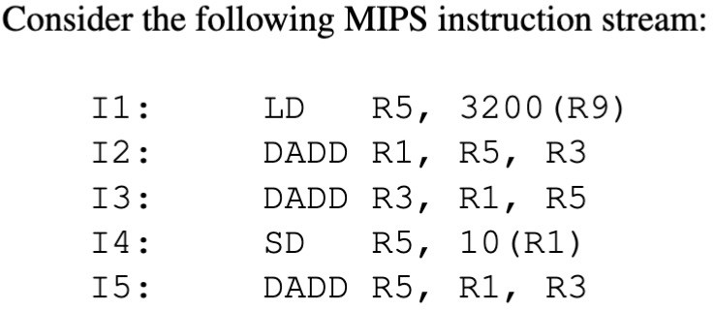
Review Question
How many cycles are needed to run the instruction stream on a pipelined MIPS with forwarding enabled?
9
10
11
25
Notes:
B. 10

Slide 50
Software Scheduling to Avoid Load Hazards
Try producing fast code with no stalls for
a = b + c;
d = e – f;
– assuming a, b, c, d ,e, and f are in memory.
Slow code:
Find Stalls!
LW LW ADD SW LW LW SUB SW
Rb, b Rc, c
Ra, Rb, Rc a, Ra
Re, e Rf, f
Rd, Re, Rf d, Rd
How many stall cycles did you find?
A. 0
B. 1
C. 2
D. 3
E. 4
Notes:
Pipeline Load Hazard Avoidance
Software scheduling is a technique used to avoid load-use data hazards in a 5-stage pipeline
by reordering instructions to prevent a dependent instruction from using the result of a load before it is available.
This is particularly important because the data from a load instruction (lw) is not available until the Memory Access (MEM) stage,
which is the fourth stage of the pipeline, but the dependent instruction may need it in the Execute (EX) stage, the third stage.
C. 2
LW and ADD with Rc
LW and SUB with Rf

Slide 51








Software Scheduling to Avoid Load Hazards
Try producing fast code with no stalls for
a = b + c;
d = e – f;
– assuming a, b, c, d ,e, and f are in memory.
Slow code:
LW LW
Stall➔ ADD
Rb, b Rc, c
Ra, Rb, Rc
LW
Stall➔ ^{SUB}
SW
Rf, f
Rd, Re, Rf d, Rd

Slide 52
Software Scheduling to Avoid Load Hazards
Try producing fast code with no stalls for
a = b + c;
d = e – f;
– assuming a, b, c, d ,e, and f are in memory.
Slow code:
LW LW
Stall➔ ADD
Rb, b Rc, c
Ra, Rb, Rc
Reorder instructions!
LW
Stall➔ ^{SUB}
SW
Rf, f
Rd, Re, Rf d, Rd

Slide 53














Software Scheduling to Avoid Load Hazards
Try producing fast code with no stalls for
a = b + c;
d = e – f;
– assuming a, b, c, d ,e, and f are in memory.
Slow code:
Fast code (no stalls):
LW LW
Stall➔ ADD
Rb, b Rc, c
Ra, Rb, Rc
LW LW
Rb, b Rc, c
ADD LW
Ra, Rb, Rc Rf, f
LW
Stall➔ SUB
SW
Rf, f
Rd, Re, Rf d, Rd
SUB SW
Rd, Re, Rf d, Rd

Slide 54
BRANCHING SCHEMES
- APPENDIX C

Slide 55
5 Steps of a MIPS Data Path (with pipeline latches)
Figure C.22
Stages: 1 Instruction
Fetch
Next PC
2
Instr. Decode Reg. Fetch
3
Execute Addr. Calc
4
Memory Access
5
Write Back
Next SEQ PC
Next SEQ PC
MUX
Adder
4
Zero?
Address
RS1
Memory
RS2
Reg File
MUX
EX/MEM
ALU
MEM/WB
Data Memory
IF/ID
ID/EX
MUX
MUX
Sign Extend
WB Data
Imm
RD
RD
RD
Old simple design put branch completion in stage 4 (Mem)
Notes:
Figure C-22 (page C-35)
Registers convey values and control information from one stage to the next.
The PC can be thought of as a pipeline register,
Most of the data paths flow from left to right, which is from earlier in time to later.
The branch condition is evaluated in the EX stage.
The ALU performs a comparison (e.g., subtraction for beq) on the two register operands read from the register file,
and the result is used to set the Zero signal, which indicates if the two values are equal.
This Zero signal is used by the branch control logic to determine if the branch condition is met.
The Program Counter (PC) is updated based on the Branch control signal and the Zero signal.

Slide 56
Control Hazard on Branch - Three Cycle Stall
(Caused if Decide Branches in 4th Stage)
Time (clock cycles)
Cycle 3 Cycle 4 Cycle 5
Addresses: in decimal
Cycle 1
Cycle 2
Cycle 6
Cycle 7
Cycle 8
I
n s t r.
12: beqz r1, 6
Ifetch
Reg
ALU
DMem
Reg
16: and r2, r3, r5
Ifetch
Reg
ALU
DMem
Reg
_{O} 20: or r6, r1, r7
r
d 24: add r8, r1, r9
e r
40: xor r10, r1, r11
Ifetch
Reg
ALU
DMem
Reg
Ifetch
Reg
ALU
DMem
Reg
Ifetch
Reg
ALU
DMem
Reg
What can be done with the 3 instructions between beq & xor?
Code between beq & xor must not start until we know beq won’t branch => 3 stalls
•
Adding 3 cycle stall after every branch (1/7 of instructions) => CPI += 3/7.

Slide 57

5 Steps of a MIPS Data Path (with pipeline latches)
Figure C.22
Stages: 1 Instruction
Fetch
Next PC
2
Instr. Decode Reg. Fetch
3
Execute Addr. Calc
4
Memory Access
5
Write Back
Next SEQ PC
Next SEQ PC
MUX
Adder
4
Zero?
Address
RS1
Memory
RS2
Reg File
MUX
EX/MEM
ALU
MEM/WB
Data Memory
IF/ID
ID/EX
MUX
MUX
Sign Extend
WB Data
Imm
RD
RD
RD
Old simple design put branch completion in stage 4 (Mem)
Notes:
Figure C-23 (page C-37)
In the IF state:
fetch the instruction
computing the new PC
and store the incremented PC both into the PC
and into a pipeline register (NPC)
for later use in computing the branch-target address.
In the ID stage:
the registers are fetched,
extend the sign of the lower 16 bits of the IR (the immediate field),
and pass along the IR and NPC.
In the EX stage:
perform an ALU operation or an address calculation;
pass along the IR and the B register (if the instruction is a store).
The branch condition is evaluated,
and we set the value of cond to 1 if the instruction is a taken branch.
In the MEM phase
cycle the memory,
write the PC if needed,
and pass along values needed in the final pipe stage.
In the WB stage:
update the register field from either the ALU output or the loaded value.

Slide 58
Branch Stall Impact if Commit in Stage 4
If CPI = 1 and 15% of instructions are branches,
  Stall 3 cycles => new CPI = 1.45 (1+3*.15) (Too much!)
Question: When is the earliest stage we can find out if PC needs to be modified?
  Answer: In pipeline stage ID of a branch instruction
  So, if a branch is not-taken (i.e., if the PC is not modified),
  maybe we can achieve only a single-cycle delay
Question: When is a taken branch’s address known?
  ALU used to compute, so EX stage
  Need two (or three) cycle delay

Slide 59
Control hazards (also see Fig. C.24, 25, 28, 29)
Two-part solution:
  Determine sooner whether branch taken or not, AND
  Compute taken branch address earlier
  MIPS branch tests if register = 0 or ≠ 0
Original 1986 MIPS Solution:
  Move zero_test to ID/RF (Inst. decode & Reg. fetch) stage from MEM
  Add extra adder to calculate new PC (Program Counter) in ID/RF stage
  Result is 1 clock cycle penalty for branch versus 3 when decided in MEM
If branch comprises 15% of instructions, what is the average CPI?
  Per cycle, have 85% of instructions executing in 1 cycle and 15% of instructions executing in 2 cycles
  An average of .85 + .3 = 1.15 cycles per instruction (or 1 + 1*.15 = 1.15).
  Worse by 15%

Slide 60

New Pipelined MIPS Data Path: Faster Branch
Figure C.28
Stages:
1
Instruction Fetch
2
Instr. Decode Reg. Fetch
Next SEQ PC
3
Execute Addr. Calc
4 5
Memory Write
Access Back
Next PC
MUX
Adder
Adder
4
Zero?
Address
RS1
Memory
RS2
Reg File
EX/MEM
ALU
MEM/WB
Data Memory
ID/EX
IF/ID
MUX
MUX
The fast branch design needs a slightly longer stage 2 cycle time, making the clock a little slower for all stages.
Sign Extend
WB Data
Imm
RD
RD
RD
• Example of interplay of instruction set design and cycle time.
Notes:
Figure C-28 (C-42):
Two important changes have been made,
each of which removes 1 cycle from the 3-cycle stall for branches.
Move both the branch-target address calculation and the branch condition decision to the ID cycle.
Write to the PC of the next instruction in the IF phase,
using either the branch-target address computed during ID
or the incremented PC computed during IF.
Downside:
The fast branch design needs a slightly longer stage 2 cycle time,
making the clock a little slower for all stages.

Slide 61
Stages:
1
Instruction Fetch
2
Instr. Decode Reg. Fetch
Next SEQ PC
3
Execute Addr. Calc
4 5
Memory Write
Access Back
Next PC
MUX
Adder
Adder
4
Zero?
Address
RS1
Memory
RS2
Reg File
EX/MEM
ALU
MEM/WB
Data Memory
ID/EX
IF/ID
MUX
MUX
The fast branch design needs a slightly longer stage 2 cycle time, making the clock a little slower for all stages.
Sign Extend
WB Data
Imm
RD
RD
RD
• Example of interplay of instruction set design and cycle time.
Notes:
Figure C-29 (C-42):
A separate adder is used to compute the branch-target address during ID.
The branch condition (Regs[IF/ID.IR_{6..10}] op 0) will also be performed.
The selection of the sequential PC or the branch-target PC still occurs during IF,
but it now uses values from the ID stage that correspond to the values set by the previous instruction.
This change reduces the branch penalty by 2 cycles:
One from evaluating the branch target and condition earlier and
One from controlling the PC selection on the same clock cycle rather than on the next cycle.
Since the value of cond is set to 0,
unless the instruction in ID is a taken branch,
the processor must decode the instruction before the end of ID.
Because the branch is done by the end of ID,
the EX, MEM, and WB stages are unused for branches.

Slide 62
Review Question
Suppose that an unpipelined multi-cycle processor executes a program with the following instruction frequencies and costs:
  Integer ALU: 50%, 4 cycles
  Load: 20%, 5 cycles
  Store: 10%, 4 cycle
  Branch: 20%, 3 cycles
Which of the following would improve the performance more?
  assume both A and B are multi-cycle implementation / same IC and cct
Reducing the branch cost to 1 cycle using better branch handling
Reducing load cost to 3 cycles using better data cache
Same speedup from both
Notes:
Original unpipelined multi-cycle:
CPI=(0.50×4)+(0.20×5)+(0.10×4)+(0.20×3)
=2.0+1.0+0.4+0.6
=4.0
Machine A:
CPI=(0.50×4)+(0.20×5)+(0.10×4)+(0.20×1)
=2.0+1.0+0.4+0.2
=3.6
Machine B:
CPI=(0.50×4)+(0.20×3)+(0.10×4)+(0.20×3)
=2.0+0.6+0.4+0.6
=3.6
Answer: C, same speedup from both.

Slide 63
Four Branch Hazard Alternatives
#1: Stall until branch direction is clearly known
#2: Predict Branch Not Taken – Easy Solution
  Execute the next instructions in sequence
  PC+4 already calculated, so use it to get next instruction
  Nullify bad instructions in pipeline if branch is actually taken
  Nullify easier since pipeline state updates are late (MEM, WB)
  47% MIPS branches not taken on average
#3: Predict Branch Taken
  53% MIPS branches taken on average
  But have not calculated branch target address in MIPS
» MIPS still incurs 1 cycle branch penalty
» Some other CPUs: branch target known before outcome

Slide 64
Last of Four Branch Hazard Alternatives
#4: Delayed Branch
  For early RISC processors
  Define branch to take place AFTER a following instruction
branch instruction
sequential successor₁ sequential successor₂
........
sequential successor_{n}
branch target if taken
Branch delay of length n
1 delay slot allows proper decision and branch target address in 5 stage pipeline
Later versions of MIPS did not use this; deeper pipeline

Slide 65
Scheduling Branch Delay Slots (Fig C.14)
A. From before branch B. From branch target C. From fall through
add $1,$2,$3 if $2=0 then
sub $4,$5,$6
add $1,$2,$3 if $1=0 then
delay slot
delay slot
add $1,$2,$3 if $1=0 then
sub $4,$5,$6
delay slot
becomes
becomes
becomes
add $1,$2,$3 if $1=0 then
if $2=0 then
sub $4,$5,$6
add $1,$2,$3
sub $4,$5,$6
add $1,$2,$3 if $1=0 then
sub $4,$5,$6
A is the best choice, fills delay slot & reduces instruction count (IC)
In B, the sub instruction may need to be copied, increasing IC
In B and C, must be okay to execute an extra sub when branch fails

Slide 66
Scheduling branch delay slot
If taken from before branch,
  branch must not depend on rescheduled instruction
  always improves performance
If taken from branch target,
  must be OK to execute rescheduled instructions if branch not taken, and may need to duplicate instructions
  improve performance when branch taken
If taken from fall through,
  must be OK to execute instructions if branch taken
  improve performance when branch not taken

Slide 67
Evaluating Branch Alternatives
Pipeline depth
Pipeline speedup =
Assume:
1 + Branch frequency × Branch penalty
4% | unconditional branch,
6% | conditional branch-untaken,
10% | conditional branch-taken
* Also see another example in Fig-C.15
Scheduling scheme | Branch penalty | CPI | speedup unpipelined | v. | Speedup stall
Stall pipeline | 3 | 1.60 | 3.1 |  | 1.0
Predict taken | 1 | 1.20 | 4.2 |  | 1.33
Predict not-taken | 1 | 1.14 | 4.4 |  | 1.40
Delayed branch | 0.5 | 1.10 | 4.5 |  | 1.45
Sample calculation
  1.60 = 1 + 3*(4+10+6)%
  1.20 = 1 + 1*(4+10+6)%
  1.14 = 1 + 1*(4+10)%
(4.5=5/1.10) (1.45=1.6/1.1)
(even for taken case, we need time to calculate taken target)
(refetch for jump, taken-branch)

Slide 68
But…. Delayed Branch Not Used in Modern CPUs
Compiler effectiveness for single branch delay slot:
  Fills about 60% of branch delay slots
  About 80% of instructions executed in branch delay slots
  are useful in computation
  About 50% (= 60% x 80%) of slots usefully filled;
  cannot fill 2 or more slots
Delayed Branch downside?
  As processor designs use deeper pipelines and multiple issue,
  the branch delay grows and needs many more delay slots
  Delayed branching soon lost effectiveness and popularity compared to more expensive but more flexible dynamic approaches
  Growth in available transistors soon permitted dynamic approaches that keep records of branch locations, taken / not-taken decisions, and target addresses
Notes:
>>
Modern processor designs generally do not use branch delay slots,
opting instead for more complex forms of branch prediction to manage pipeline hazards.
Branch delay slots are largely obsolete in modern CPU architectures,
primarily because longer and more complex pipelines
make a single delay slot insufficient to hide the increased branch latency

Slide 69
Pipelining Summary
Pipelining can speed instruction execution (throughput)
Speed Up ≃ Pipeline Depth; if ideal CPI is 1, then:
Pipeline depth 1 + Pipeline stall CPI
^{Cycle Time}unpipelined
Speedup =
×
Cycle Time_{pipelined}
Hazards limit performance on computers by stalling:
  Structural: need more HW resources
  Data (RAW, WAR, WAW): need forwarding, compiler scheduling
  Control: delayed branch or branch (taken / not-taken) prediction

